Slide 1
WELCOME TO The HOWARD SCHOOL

Slide 2
GCSE English Literature
Candidates will be awarded a number of 1-9 in the Summer of 2024.
The exams take place as follows:
Monday May 13th and Monday May 20th 2024

Slide 3
Component 1: Shakespeare and Poetry (2 hours) (40%)
What do we study?
A Poetry anthology of 18 poems
What do we need to know?
18 poems – the content of each poem and how themes (such as power; suffering; love; relationships, for example) are presented
PLUS the contextual factors surrounding them –society and issues at the time; the poets’ motives for writing
What do we study?
Shakespeare’s ‘Macbeth’
What do we need to know?
The whole play – a timeline of events, characters, relationships and themes which run throughout

Slide 4
Component 2: Post-1914 Prose/Drama, 19th Century Prose and Unseen Poetry (2 hours 30 minutes) (60%)
What do we study?
Lord of the Flies – William Golding
What do we need to know?
The whole novel – a timeline of events, characters, relationships and themes which run throughout
What do we study?
A Christmas Carol – Charles Dickens OR Jekyll & Hyde – Robert Louis Stevenson
What do we need to know?
The whole texts– a timeline of events; characters, relationships and themes which run throughout
PLUS the contextual factors surrounding it: society and issues at the time; Dickens’/ Stevenson’s motives for writing

Slide 5
Component 2: Post-1914 Prose/Drama, 19th Century Prose and Unseen Poetry (2 hours 30 minutes) (60%)
What do we study?
Unseen Poetry – modern day poems that cover relatable themes such as old age; the seasons; children growing up
What do we need to know?
Nothing!! There is nothing to revise for this section – this is all about practising the skills of analysis with texts you’ve never seen so there are no quotes to learn at all!!

Slide 6
English Literature – key messages:
100% EXAM- pupils are being totally independent. What they produce on exam day is what will be marked for their final grade
All of these exams are closed book – our students need to RECALL DETAILS AND QUOTES FROM ALL 4 TEXTS: THE PLAY, THE 2 NOVELS AND THE 18 POEMS

Slide 7
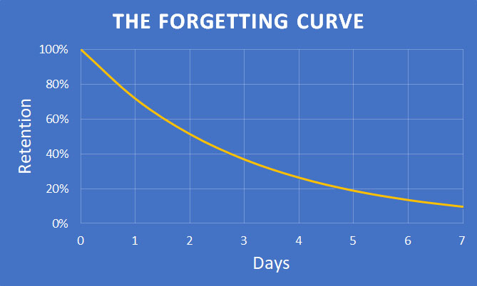

Slide 8
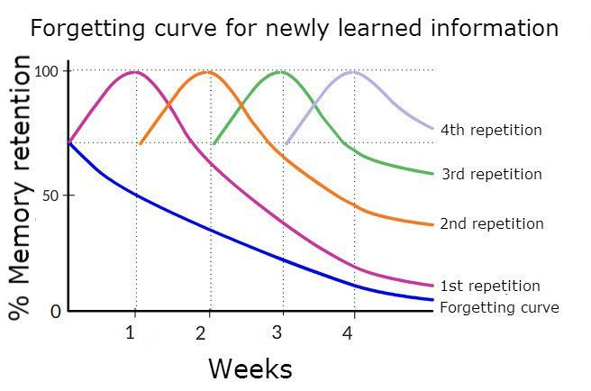

Slide 9
So what can we do to help?
The more revision and practise of essay style responses that are done, the higher students can achieve.
In the class room: we can recall details and evidence and practise and feedback on analysis
At home, students need your support to ensure they are able to add to their revision – through helping to organise their time to even testing them on the texts!

Slide 10
So what can we do to help?
PiXL Lit App – logins available to collect today!
Revision workbooks – available to collect today!
A guide to revision from now until the exams – available to collect today!
Knowledge Organisers – already allocated!
Access to learning activities on Seneca
Lessons and resources available all the time on Google classroom!

