Slide 1


Lord of the Flies
Slow essay planning
Speed planning
Assessment
Exam questions and model answers
This booklet will help you understand what is expected of you in your exam. We will learn how to answer the question effectively and how to avoid common errors.
Name: ​
Teacher: ​
Class:

Slide 2
I do
I have completed the first slow planning section for an exam question.
Read through and follow the slow planning structure. You will then attempt to write an essay response using the plan I have produced for you.
This will help you understand the process for dissecting an exam question, how to appraoch the extract and cover the wider novel.
In your exam you will not have enough time to make an extensive plan like this. As you become more confident, we will gradually reduce the planning process.
After you have completed the essay send it to Miss Webb for feedback.
a.webb@childwallssa.org

Slide 3
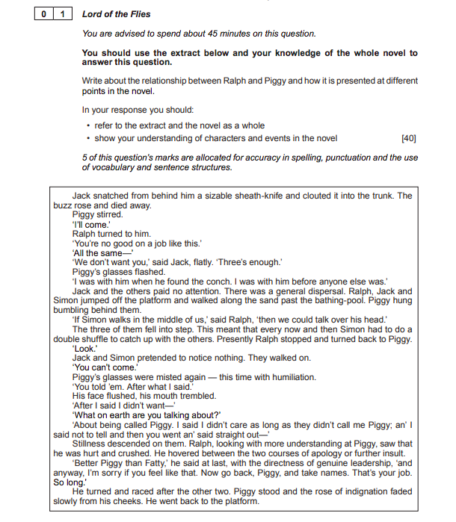
The question
1
2
3
4
Highlight the key words in the text to ensure you find the focus of the question.
Read the extract and identify where in the novel this extract is from. What key events happened before and after this.
Read the extract again and highlight quotations that fit the focus of the question. Ensure you identify quotations from the beginning, middle and the end of the extract.
Now plan to include your knowledge of the wider novel. What key events, characters , themes and symbols relate to the question focus? What quotations can you recall to support your points.

Slide 4



Planning
WAGOLL
Focus: The relationship between Ralph and Piggy
Summarise the relationship between Ralph and Piggy in less than 50 words.
Ralph and Piggy have contrasting appearances. Piggy is dependent on Ralph to survive and remains loyal to him when the tribe splits. Ralph and Piggy represent the hope for rescue and the civility of society that breaks down over the course of the novel. Piggy is the most intelligent but lacks the legitimacy to be a leader. Piggy is marginalised and bullied by the other boys. Whereas, Ralph is elected leader but struggles to maintain his power.
What is happening in the extract? What happened before and after?
In this extract the boys have decided to explore and go over the mountain to check it is an island. This is the beginning of Piggy being ostracized by the other boys specifically Jack. Ralph hesitates between comforting and insulting Piggy further – this reflects the torment Ralph feels throughout the novel during his leadership. Before this Piggy and Ralph met first and then the boys has a vote and elected Ralph as leader. After this extract the novel progresses and introduces new conflicts to Ralph and Piggy's relationship.
What language could you analyse? Think of their physical descriptions, speech and dialogue – how does this compare to the wider novel?
Piggy's dependency on Ralph and the conch - 'I was with his when he found the conch. I was with him before anyone else'
Piggy's marginalised 'We do not want you' 'paid no attention' 'glasses misted again – this time with humiliation' 'Piggy'
Ralph's leadership - 'looking with more understanding' 'hovered between the two courses of apology or further insult'
What themes relate to their relationship?
Leadership/power
Friendship/loyalty
Law and order
Fear
Identity
Civility Vs Savagery
Good v evil
What symbols/motifs/images relate to their relationship?
Glasses
Fire
Conch
Lord of the flies
Pigs
Death
What are Golding's main intentions? What is Golding trying to show the reader through their relationship?
Ralph and Piggy represent humanity's flawed resistance of primitive behaviour. They represent advancement of intelligence and the rules of a civilised world. As the novel progresses the vulnerability of Piggy is exposed and through his murder Golding is perhaps arguing that humanity will always default to their innate human evil.
Link to the question
How is structure used?
What is the impact on the reader?

Slide 5
Extract quotations
WAGOLL
Focus: The relationship between Ralph and Piggy
TRACK
You must select quotations from the beginning, middle and the end of the extract.
Identify the short quotations you want to analyse and explode them in the boxes provided – planning what you would analyse. Consider links to the question focus, themes, other characters and writer's intentions.
WAGOLL
Beginning
'You're no good on a job like this' - lacking worth and physical ability
'We don't want you' - marginalized for being different – link to British colonialism
'I was with him when he found the conch. I was with him before anyone else'' - loyalty and dependence on Ralph and the conch for legitimacy.
WAGOLL
Middle
'Paid no attention' - he has no legitimacy, no power, no stature
'bumbling behind them' - confused, incompetent
'look' - command
'Piggy's glasses were misted again - this time with humiliation' - sensitive, crying, embarrassed
'His face flushed, his mouth trembled' - - sensitive, crying, embarrassed
'Piggy' - pigs are intelligent but hunted on the island by savages
'hi
WAGOLL
End
'looking with more understanding' - Ralph's empathy
'saw that he was hurt and crushed' - responsibility for impact of his actions on Piggy/morality
'hovered between the two courses of apology or further insult' - Ralph's leadership – torn
'Better Piggy than Fatty' - lesser evil
'directness of genuine leadership' - power, authority
'take names. That's your job' - register, order. Civility – Ralph delegating
'rose of indignation faded slowly from his cheeks' - his annoyance fades away with his inability to do anything about it

Slide 6

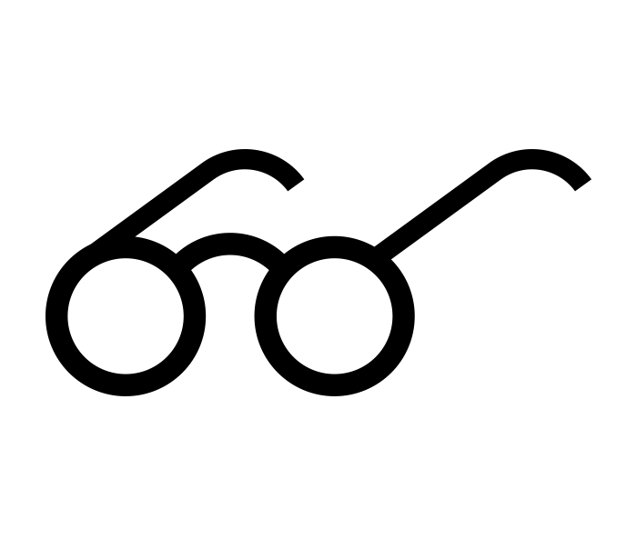







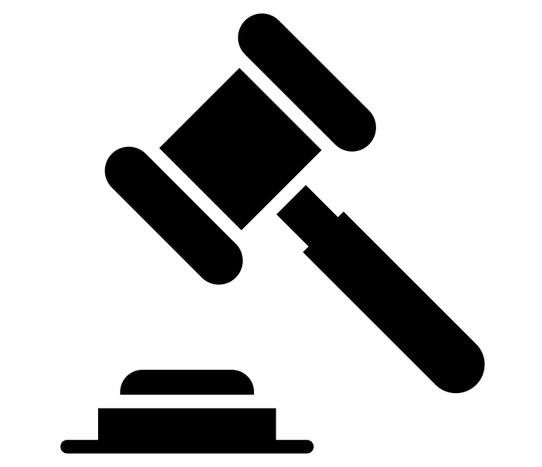
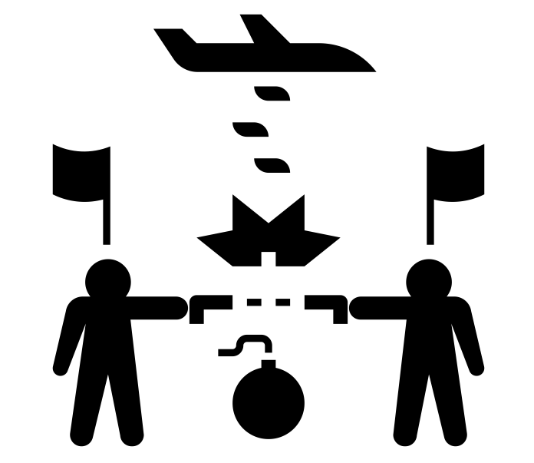
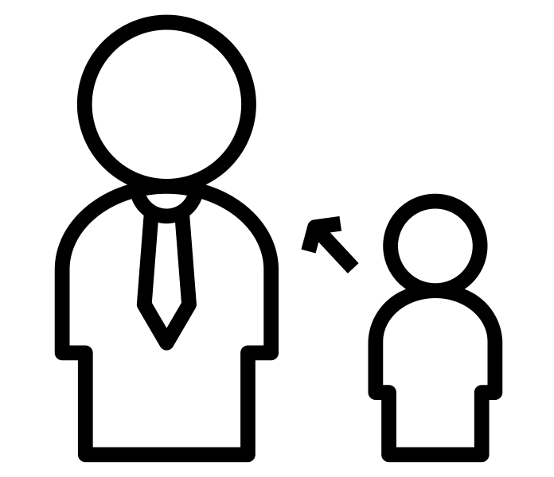






WAGOLL
Wider novel
Focus: The relationship between Ralph and Piggy
Key events in their relationship
What symbols/motifs/images are linked to both characters and their relationship?
How is the relationship established?
Two of the boys, Ralph and Piggy, meet. They find a large conch shell and blow it loudly to summon the rest of the boys. Introduced to the juxtaposition of their appearances.
WAGOLL
Hope for rescue – connection to civilisation
First ‘death’ of the littleun
fire is a technology that threatens destruction if it gets out of control.
Represents civilisation and democrasy. The legitamacy of the conch erodes as they descend into savagery.
Piggy's intelligence is symbolised through his glasses. When the boys descend into savagery – Piggy and his glasses represent a scientific advancement.
What happens when the tribe splits? How does Piggy show his loyalty?
Ralph needs Piggy's wisdom to remind him of why they need the fire when Ralph seems to forget the meaning of the fire and then tries to cover for him. 'You're chief Ralph. You remember everything'. Ralph as has 'a new understanding that Piggy had given him' when tells him that Jack hates him. He understands the characters of the other boys ' ' If Jack was chief he'd have all hunting and no fire. We'd be here until we died'. Piggy is also Ralph's biggest supporter because he can see that Ralph is obviously a more responsible leader than Jack, but being different, Piggy's support has the effect of adding to Ralph's isolation.
What physical description can you discuss?
How do they differ?
Piggy is described: his jacket is greasy; he is very fat and his spectacles are thick. He gets out of breath because of his asthma, and he obviously has diarrhea from eating too much fruit. His image is not improved by the way he speaks. His poor grammar suggests that he comes from a different social background to Ralph. Ralph is is well-built, athletic, and a good swimmer, “but there was a mildness about his mouth and eyes that proclaimed no devil.” He is, at first, delighted by the tropical lushness of the island and the freedom from adult constraints. He rejects Piggy’s overtures of friendship and betrays Piggy’s nick-name to Jack and the other boys. Ralph accepts Piggy’s advice when it suits him, as in the suggestion to use the conch to summon the other boys, but he is more naturally drawn to Jack. When he is elected chief Ralph appeases Jack by giving him and his choir the job of hunters. He displays his leadership skills straight away by organising a reconnaissance party to scout the island
WAGOLL
How does Piggy depend on Ralph for survival?
Without rules and order, people like Piggy are vulnerable. With the conch, everyone gets a fair chance. If he is holding the conch, it does not matter if he is fat and unathletic. His voice should matter just as much as anyone else's but as we see in the novel this is not always the case.
Interesting Piggy’s hair does not grow – like his body is refusing to descend into savageness or could this be another sign of inferiority?
What themes do both characters and their relationships link to?
How do they react to Simon's death?
As the brainy representative of civilisation, Piggy asserts that "Life . . . is scientific." Ever the pragmatist, Piggy complains, "What good're you doing talking like that?" when Ralph brings up the highly charged issue of Simon's death at their hands. Piggy tries to keep life scientific despite the incident, "searching for a formula" to explain the death. He asserts that the assault on Simon was justifiable because Simon asked for it by inexplicably crawling out of the forest into the ring. "It was an accident... and that's that'.
What are Goldings intentions?
What is the desired effect on the reader?
Consider what Golding is: advocating criticising celebrating warning teaching exposing. Link your big ideas to the themes above.
How does Ralph react to Piggy's death?
The death of Piggy is foreshadowed by the hunting and killing of the pigs on the island. Roger sees Piggy as a "bag of fat". Only a few chapters earlier, the pigs are referred to as "bloated bags of fat". As the descent into savagery continue, the line between prey and human blurs. "Which is better—to have rules and agree, or to hunt and kill?" - Piggy dies trying to reason with the boys and restore order. Piggy and the conch are destroyed together by the rock Roger levers. Thus both intelligence and the symbol of authority are dead. Chaos has won over order. At the end, there is 'no piggy to talk sense' and Ralph mourns the fall: "the true, wise friend called Piggy".
Golding could perhaps be advocating that we need to work hard to change the future of mankind.
Golding may be critising mankind due to his belief that we all have a primitive desire for evil.
WAGOLL
Golding may be celebrating loyalty and friendship though Piggy and Ralph.
Golding may be warning that mankind is attracted to evil like a bee is attracted to honey.
Golding potentially be teaching readers about his views on the British Empire.
Golding might be exposing his thoughts on totalitarian states through the destruction of Ralph's leadership and Piggy's life by Jack.

Slide 7
Essay Plan – version two, blend extract and wider novel analysis
WAGOLL
Focus: The relationship between Ralph and Piggy
Introduction Overview that directly answers the question. Discuss structure immediately – how does the relationship start, alter/change and end. Place the extract in that structure. Comment on Golding's intentions/big picture. | Allegorical microcosm of the world Golding knew and participated in. In this extract The boys have decided to explore and go over the mountain to check it's an island. Beginning of Piggy being ostracized by the other boys specifically Jack. Ralph hesitates between comforting and insulting Piggy further Before this Piggy and Ralph met first Boys has a vote and elected Ralph as leader. After he novel progresses and introduces new conflicts to Ralph and Piggy's relationship.
Outline the big picture ideas you'll discuss Extended introduction to develop your big ideas further. Comment on the progressive journey throughout novel. | Despite intelligence and democracy mankind is flawed. Innate human evil. Conch, glasses, fire. The tribe splitting Piggy depending on Ralph Simon's death Piggy's death
Big idea one – beginning of the novel Topic sentence that relates to the question focus Embed short relevant quotations/language/methods from the extract Link to wider novel and give supporting quotations where possible Analyse effect on the reader Discuss Goldings intentions | Physical differences Piggy's intelligence Democracy leadership Conch Legitimacy
Big idea two – middle of the novel Topic sentence that relates to the question focus Discuss how things have changed as the novel progresses Embed short relevant quotations/language/methods from the extract Link to wider novel and give supporting quotations where possible Analyse effect on the reader Discuss Goldings intentions | Fire Death of a little'un Jack's treatment of Piggy Splitting of the tribe The boys' reaction to Simon's death
Big idea three – end of the novel Topic sentence that relates to the question focus Discuss how things have changed overall as the novel concludes Embed short relevant quotations/language/methods from the extract Link to wider novel and give supporting quotations where possible Analyse effect on the reader Discuss Goldings intentions | The stealing of piggy's glasses Destruction of the conch Piggy's death Rescue – ralph being hunted
Conclusion A brief summary of your main discussion points. Answer the question. Summarise Golding's intentions. Emphasise the impact on the reader. | Golding might be exposing his thoughts on totalitarian states through the destruction of Ralph's leadership and Piggy's life by Jack. Golding may be critising mankind due to his belief that we all have a primitive desire for evil.
WAGOLL

Slide 8
Big ideas – topic sentences
Focus: The relationship between Ralph and Piggy
Prepare your big ideas
Write three big idea sentences using the formula below – these are your main responses to the question.
1
Writer's name...
Golding (spelled correctly and with a capital letter)
2
...Says or (or does) ...
Introduces
Relfects
Alludes to
Challenges
Questions
Explores
Mirrors
Illustrates
Suggests
Creates
Reveals
3
...something...
Theme
Notion
Idea
Belief
4
...in the text...
...throughout the novel...
...across the text...
...from the beginning...
...by the end...
1
Golding might be exposing his thoughts on totalitarian states through the destruction of Ralph's leadership and Piggy's life by Jack.
WAGOLL
2
Golding may be critising mankind due to his belief that we all have a primitive desire for evil when Ralph and Piggy participate in the tribal dance murder of Simon.
3
Golding is mirroring how intelligence and scientific advancement still isn't enough to overcome mankind's innate human evil in the real world through the death of Piggy.
Prepare your topic sentences.
Write three topic sentences using the formula below – these formulate your detailed response in each of your three big ideas.
1
Writer's name...
e.g Blake
Shakespeare
Orwell
Wells
2
writing verb...
Presents
Creates
Describes
Portrays
Suggests
Implies
Illustrates
3
Your point...
e.g. Well's highlights the inequality of Victorian society
4
...comma
,
5
QUOTATION...
In single 'quotation marks'
Keep it short (six words or less)
Punctuation inside quotation marks!
Topic sentence: Golding introduces the marginalisation of Piggy to perhaps represent his views on British colonalism, 'We don't want you'.
Topic sentence: Golding exposes Piggy's lack of legitamacy as a reason he could never be a leader, 'Bumbling behind them.'
Topic sentence: Golding illustrates Ralph taking responsibility for his morality, 'saw that he was hurt and crushed.'

Slide 9
Develop your analysis
Focus: The relationship between Ralph and Piggy
Choose one Big idea and topic sentence first to practice developing your analysis.
Success Criteria ​
WHAT?​ What big idea or statementdo you want to discuss?​ | Make clear points using the formula (name, verb, point, quotation) ​
HOW?​ Writer's craft, language.​ How does the context ortheory influence youranalysis?​ | Use short, relevant quotations to support each point​
 | Identify literary terminology (e.g. emotivelanguage, violent imagery, metaphor) ​
 | Zoom in and analyselanguage in detail ​
 | Comment on the historical context ​
WHY?​ What is the desired effect on the reader? What does the writer want tohighlight?​ | Comment on how the reader would react (does this change depending on time period) ​
 | Comment on the writer's intentions ​
Topic sentence: | Golding illustrates Ralph taking responsibility for his morality, 'saw that he was hurt and crushed.'
Quotation: Shorten: | 'saw that he was hurt and crushed.' 'hurt and crushed'
Device: | Emotive verbs
Language: Connotations: | Crushed Demoralised, deflated
Multiple meanings: | Foreshadow how he dies, ownership of his actions – civilised.
Link to wider novel: | Ralph also tries to take responsibility for his part in Simon's death but Piggy refuses to accept this, "What good're you doing talking like that?" He tries to rationalise what happened "It was an accident... and that's that'.
Themes: | Human nature – civility Vs Savagery Innate human evil Social responsibility Law and order
Context/Golding's intentions: | Social systems, political systems were composed, detached from the real nature of man. Golding believed that the condition of man was to be a morally diseased creation and wanted to trace the connection between his diseased nature and the international mess he gets himself into.
Time period: Effect on the reader: | War Conflicts are happening now – is Goldings message still relevant to a modern reader?

Slide 10
Write up your analysis
Focus: The relationship between Ralph and Piggy
Follow the success criteria and use your planning to write your extended analysis
Success Criteria ​
WHAT?​ What big idea or statementdo you want to discuss?​ | Make clear points using the formula (name, verb, point, quotation) ​
HOW?​ Writer's craft, language.​ How does the context ortheory influence youranalysis?​ | Use short, relevant quotations to support each point​
 | Identify literary terminology (e.g. emotivelanguage, violent imagery, metaphor) ​
 | Zoom in and analyselanguage in detail ​
 | Comment on the historical context ​
WHY?​ What is the desired effect on the reader? What does the writer want tohighlight?​ | Comment on how the reader would react (does this change depending on time period) ​
 | Comment on the writer's intentions ​
Golding is mirroring how intelligence and scientific advancement still isn't enough to overcome mankind's innate human evil in the real world. In the extract, Golding illustrates Ralph taking responsibility for his morality, 'saw that he was hurt and crushed.' Golding uses the emotive verb, 'hurt ' to reveal how Piggy feels demoralised and deflated. Ralph recognises that he has contributed to evoking these emotions and is therefore still conditioned by societal expectations. Golding could also be foreshadowing Piggy's death through the violent verb 'crushed' as this is how Piggy dies after Roger pushes a leaver to release the rock that ultimately crushes Piggy. Ralph also tries to take responsibility for his part in Simon's death but Piggy refuses to accept this, "What good're you doing talking like that?" He tries to rationalise what happened "It was an accident... and that's that'. This could link to Golding's views that even the most civilised of mankind will make excuses for their innate human evil and the sins humankind commits. Golding believed that the condition of man was to be a morally diseased creation and wanted to trace the connection between his diseased nature and the international mess he gets himself into. As this novel was published after the war the reader would potentially have lived through the atrosities and aftermath of suffering. A modern-day reader would also undersand that examples of mankind causing suffering is still a prominient issue in society.

Slide 11
Write your introduction
Focus: The relationship between Ralph and Piggy
Introduction writing
Introduction​
Overview that directly answers the question. ​
Discuss structure immediately – how does the relationship start, alter/change and end. ​
Place the extract in that structure. ​
Comment on Golding's intentions/big picture.
Lord of the Flies is an allegorical microcosm of the world Golding knew and participated in.
In this extract the boys have decided to explore and go over the mountain to check it is an island. This is the beginning of Piggy being ostracized by the other boys, specifically Jack. Ralph hesitates between comforting and insulting Piggy further – this reflects the torment Ralph feels throughout the novel during his leadership. Before the extract Piggy and Ralph met first and found the conch and then the boys had a vote and elected Ralph as leader. After this extract the novel progresses and introduces new conflicts to Ralph and Piggy's relationship. They become ostrasised as the tribe splits. Ralph and Piggy represent civilisation and rational thought. Golding's views on humanity are well documented, he believes humans have a desire for evil the same way bees have a desire for honey. Ralph and Piggy represent the resistence against these desires however Golding ensures they still have flaws and the potential for evil. At the end of the novel Ralph mourns the fall of: "the true, wise friend called Piggy". Golding is perhaps trying to show the reader that despite intelligence and democracy, mankind is flawed.

Slide 12
Write your essay
Focus: The relationship between Ralph and Piggy
Follow the success criteria and use your planning to write your essay response

Slide 13
Write your essay
Focus: The relationship between Ralph and Piggy
Follow the success criteria and use your planning to write your essay response

Slide 14
Write your essay
Focus: The relationship between Ralph and Piggy
Follow the success criteria and use your planning to write your essay response

Slide 15
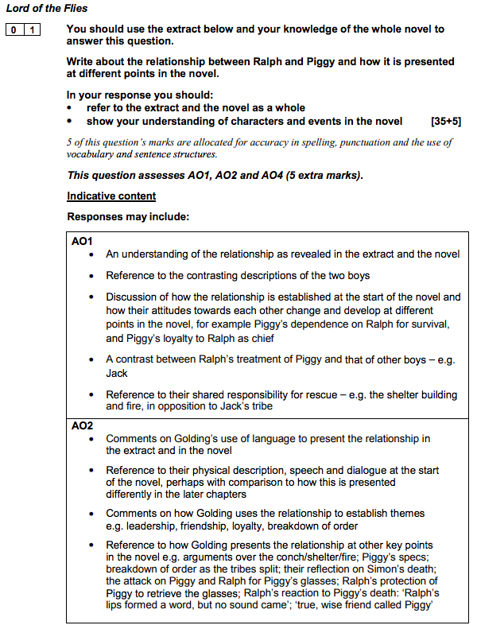
Mark Scheme
Focus: The relationship between Ralph and Piggy
AO1: Read, understand and respond to texts. Use textual references, including quotations, to support ideas.
AO2: Analyse language, form and structure using the correct subject terminology.
AO3: Show an understanding of the relationships between texts and the contexts in which they were written.
AO4: Use a range of vocabulary for clarity, purpose and effect, with accurate spelling, punctuation and grammar.
Although AO3 isn't explicitly marked in this question it is important you embed context in your response to strengthen your analysis of the writer's intentions and the desired effect on the reader.

Slide 16
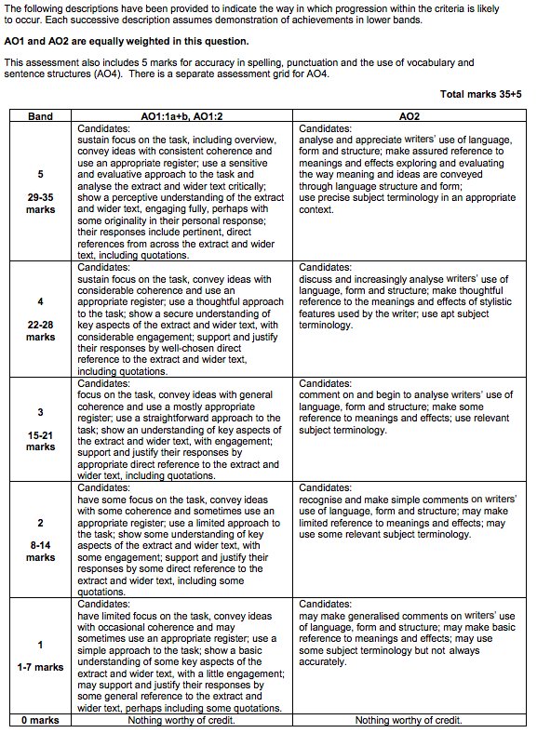
Mark Scheme
Focus: The relationship between Ralph and Piggy

Slide 17
You do
You are now going to complete the slow planning tasks for a new extract. You will then practice the skills required (check back through the WAGOLLs for guidance.) You will then write your essay response.
Ensure you write the focus of the question at the top of each page.
This will help you understand the process for dissecting an exam question, how to appraoch the extract and cover the wider novel.
In your exam you won't have enough time to make an extensive plan like this. As you become more confident, we will gradually reduce the planning process.
The next essay will have a shorter planning process and I'd advise completing this in timed conditions.

Slide 18
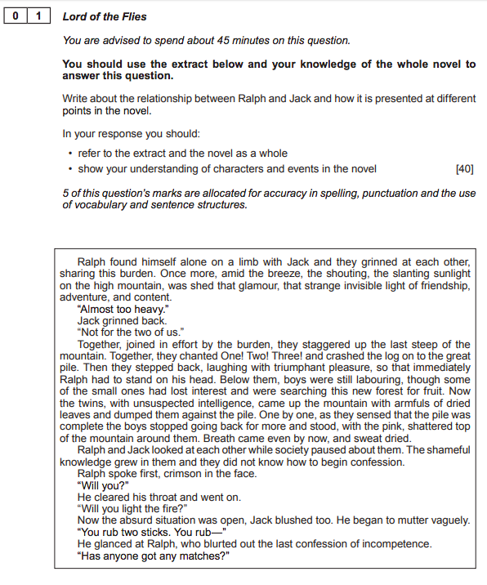
The question
1
2
3
4
Highlight the key words in the text to ensure you find the focus of the question.
Read the extract and identify where in the novel this extract is from. What key events happened before and after this.
Read the extract again and highlight quotations that fit the focus of the question. Ensure you identify quotations from the beginning, middle and the end of the extract.
Now plan to include your knowledge of the wider novel. What key events, characters , themes and symbols relate to the question focus? What quotations can you recall to support your points.

Slide 19
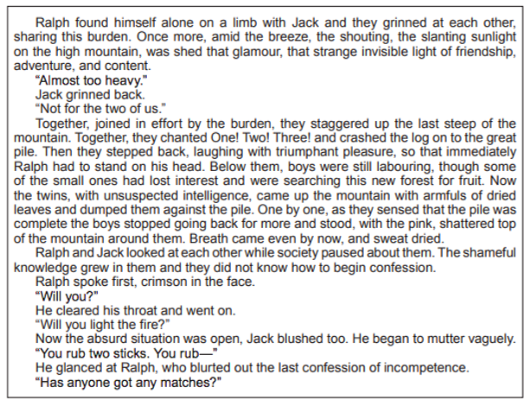
Planning
Focus:
Summarise the relationship between Ralph and Jack in less than 50 words.
What is happening in the extract? What happened before and after?
What language could you analyse?
What themes relate to their relationship?
What symbols/motifs/images relate to their relationship?
What are Golding's main intentions? What is Golding trying to show the reader through their relationship?
Link to the question
How is structure used?
What is the impact on the reader?

Slide 20
Extract quotations
Focus:
TRACK
You must select quotations from the beginning, middle and the end of the extract.
Identify the short quotations you want to analyse and explode them in the boxes provided – planning what you would analyse. Consider links to the question focus, themes, other characters and writer's intentions.
Beginning
Middle
'hi
End

Slide 21
Wider novel
Focus:
Key events in their relationship
What symbols/motifs/images are linked to both characters and their relationship?
How is the relationship established?
How do their leadership styles differ?
alph is obviously a more responsible leader than Jack, but being different, Piggy's support has the effect of adding to Ralph's isolation.
How does their relationship change throughout the novel? What causes this?
How is the fall of civilisation is presented through their relationship?
What themes do both characters and their relationships link to?
Was the tribe splitting inevitable? How do other characters react to both characters.
What are Goldings intentions?
What is the desired effect on the reader?
Consider what Golding is: advocating criticising celebrating warning teaching exposing. Link your big ideas to the themes above.
What conflicts do they have throughout the novel? How does violence increase?

Slide 22
Essay Plan – blend extract and wider novel analysis
Focus:
Introduction Overview that directly answers the question. Discuss structure immediately – how does the relationship start, alter/change and end. Place the extract in that structure. Comment on Golding's intentions/big picture.
Outline the big picture ideas you'll discuss Extended introduction to develop your big ideas further. Comment on the progressive journey throughout novel.
Big idea one – beginning of the novel Topic sentence that relates to the question focus Embed short relevant quotations/language/methods from the extract Link to wider novel and give supporting quotations where possible Analyse effect on the reader Discuss Goldings intentions
Big idea two – middle of the novel Topic sentence that relates to the question focus Discuss how things have changed as the novel progresses Embed short relevant quotations/language/methods from the extract Link to wider novel and give supporting quotations where possible Analyse effect on the reader Discuss Goldings intentions
Big idea three – end of the novel Topic sentence that relates to the question focus Discuss how things have changed overall as the novel concludes Embed short relevant quotations/language/methods from the extract Link to wider novel and give supporting quotations where possible Analyse effect on the reader Discuss Goldings intentions
Conclusion A brief summary of your main discussion points. Answer the question. Summarise Golding's intentions. Emphasise the impact on the reader.

Slide 23
Big ideas – topic sentences
Focus:
Prepare your big ideas
Write three big idea sentences using the formula below – these are your main responses to the question.
1
Writer's name...
Golding (spelled correctly and with a capital letter)
2
...Says or (or does) ...
Introduces
Relfects
Alludes to
Challenges
Questions
Explores
Mirrors
Illustrates
Suggests
Creates
Reveals
3
...something...
Theme
Notion
Idea
Belief
4
...in the text...
...throughout the novel...
...across the text...
...from the beginning...
...by the end...
1
2
3
Prepare your topic sentences.
Write three topic sentences using the formula below – these formulate your detailed response in each of your three big ideas.
1
Writer's name...
e.g Blake
Shakespeare
Orwell
Wells
2
writing verb...
Presents
Creates
Describes
Portrays
Suggests
Implies
Illustrates
3
Your point...
e.g. Well's highlights the inequality of Victorian society
4
...comma
,
5
QUOTATION...
In single 'quotation marks'
Keep it short (six words or less)
Punctuation inside quotation marks!
Topic sentence:
Topic sentence:
Topic sentence:

Slide 24
Develop your analysis
Focus:
Choose one Big idea and topic sentence first to practice developing your analysis.
Success Criteria ​
WHAT?​ What big idea or statementdo you want to discuss?​ | Make clear points using the formula (name, verb, point, quotation) ​
HOW?​ Writer's craft, language.​ How does the context ortheory influence youranalysis?​ | Use short, relevant quotations to support each point​
 | Identify literary terminology (e.g. emotivelanguage, violent imagery, metaphor) ​
 | Zoom in and analyselanguage in detail ​
 | Comment on the historical context ​
WHY?​ What is the desired effect on the reader? What does the writer want tohighlight?​ | Comment on how the reader would react (does this change depending on time period) ​
 | Comment on the writer's intentions ​
Topic sentence:
Quotation: Shorten:
Device:
Language: Connotations:
Multiple meanings:
Link to wider novel:
Themes:
Context/Golding's intentions:
Time period: Effect on the reader:

Slide 25
Write up your analysis
Focus:
Follow the success criteria and use your planning to write your extended analysis
Success Criteria ​
WHAT?​ What big idea or statementdo you want to discuss?​ | Make clear points using the formula (name, verb, point, quotation) ​
HOW?​ Writer's craft, language.​ How does the context ortheory influence youranalysis?​ | Use short, relevant quotations to support each point​
 | Identify literary terminology (e.g. emotivelanguage, violent imagery, metaphor) ​
 | Zoom in and analyselanguage in detail ​
 | Comment on the historical context ​
WHY?​ What is the desired effect on the reader? What does the writer want tohighlight?​ | Comment on how the reader would react (does this change depending on time period) ​
 | Comment on the writer's intentions ​

Slide 26
Write your introduction
Focus:
Introduction writing
Introduction​
Overview that directly answers the question. ​
Discuss structure immediately – how does the relationship start, alter/change and end. ​
Place the extract in that structure. ​
Comment on Golding's intentions/big picture.

Slide 27
Write your essay
Focus:
Follow the success criteria and use your planning to write your essay response

Slide 28
Write your essay
Focus:
Follow the success criteria and use your planning to write your essay response

Slide 29
Write your essay
Focus:
Follow the success criteria and use your planning to write your essay response

Slide 30
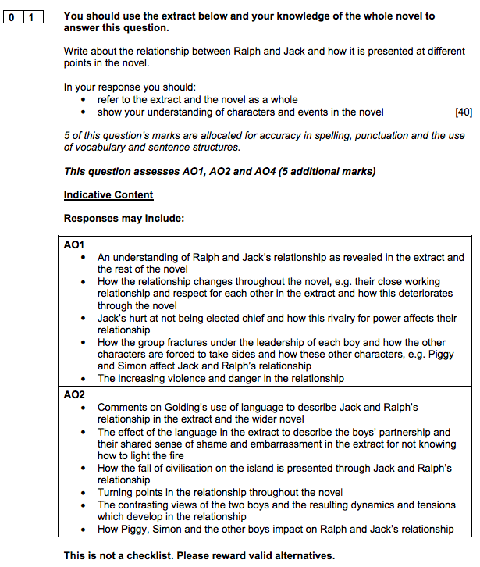
Mark Scheme
Focus: The relationship between Ralph and Piggy
AO1: Read, understand and respond to texts. Use textual references, including quotations, to support ideas.
AO2: Analyse language, form and structure using the correct subject terminology.
AO3: Show an understanding of the relationships between texts and the contexts in which they were written.
AO4: Use a range of vocabulary for clarity, purpose and effect, with accurate spelling, punctuation and grammar.
Although AO3 isn't explicitly marked in this question it is important you embed context in your response to strengthen your analysis of the writer's intentions and the desired effect on the reader.

Slide 31
Mark Scheme
Focus: The relationship between Ralph and Piggy

Slide 32
You do
In your exam you won't have enough time to make an extensive plan like this. As you become more confident, we will gradually reduce the planning process.
The next essay will have a shorter planning process and I'd advise completing this in timed conditions.
This think about theme, symbols, key events, characters and writer's intentions like you have in previous slow planning tasks.
Ensure you write the focus of the question at the top of each page.

Slide 33
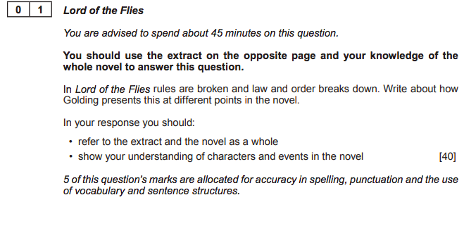
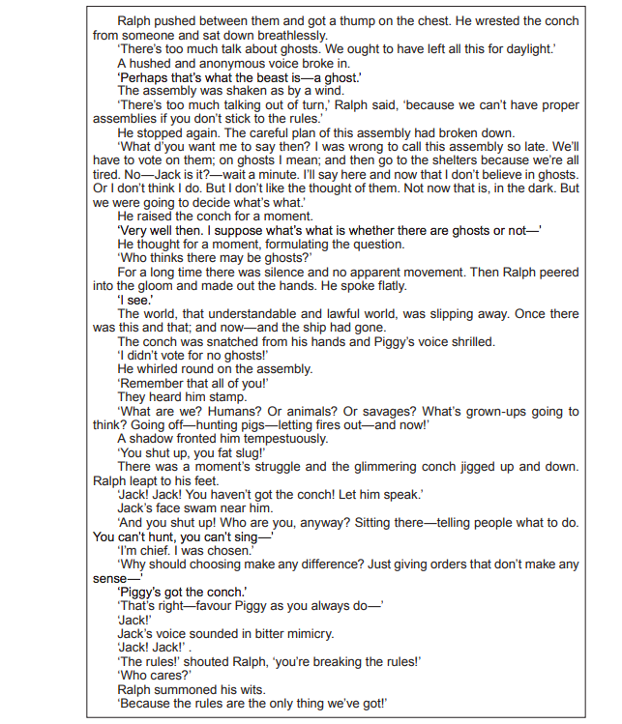
The question
1
2
3
4
Highlight the key words in the text to ensure you find the focus of the question.
Read the extract and identify where in the novel this extract is from. What key events happened before and after this.
Read the extract again and highlight quotations that fit the focus of the question. Ensure you identify quotations from the beginning, middle and the end of the extract.
Now plan to include your knowledge of the wider novel. What key events, characters , themes and symbols relate to the question focus? What quotations can you recall to support your points.

Slide 34
Extract quotations
Focus:
TRACK
You must select quotations from the beginning, middle and the end of the extract.
Identify the short quotations you want to analyse and explode them in the boxes provided – planning what you would analyse. Consider links to the question focus, themes, other characters and writer's intentions.
Beginning
Middle
'hi
End

Slide 35
Essay Plan – blend extract and wider novel analysis
Focus:
Introduction Overview that directly answers the question. Discuss structure immediately – how does the relationship start, alter/change and end. Place the extract in that structure. Comment on Golding's intentions/big picture.
Outline the big picture ideas you'll discuss Extended introduction to develop your big ideas further. Comment on the progressive journey throughout novel.
Big idea one – beginning of the novel Topic sentence that relates to the question focus Embed short relevant quotations/language/methods from the extract Link to wider novel and give supporting quotations where possible Analyse effect on the reader Discuss Goldings intentions
Big idea two – middle of the novel Topic sentence that relates to the question focus Discuss how things have changed as the novel progresses Embed short relevant quotations/language/methods from the extract Link to wider novel and give supporting quotations where possible Analyse effect on the reader Discuss Goldings intentions
Big idea three – end of the novel Topic sentence that relates to the question focus Discuss how things have changed overall as the novel concludes Embed short relevant quotations/language/methods from the extract Link to wider novel and give supporting quotations where possible Analyse effect on the reader Discuss Goldings intentions
Conclusion A brief summary of your main discussion points. Answer the question. Summarise Golding's intentions. Emphasise the impact on the reader.

Slide 36
Write your essay
Focus:
Follow the success criteria and use your planning to write your essay response

Slide 37
Write your essay
Focus:
Follow the success criteria and use your planning to write your essay response

Slide 38
Write your essay
Focus:
Follow the success criteria and use your planning to write your essay response

Slide 39
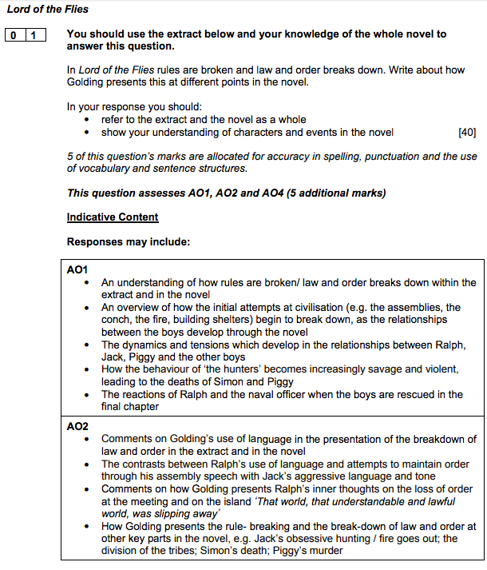
Mark Scheme
Focus: The relationship between Ralph and Piggy
AO1: Read, understand and respond to texts. Use textual references, including quotations, to support ideas.
AO2: Analyse language, form and structure using the correct subject terminology.
AO3: Show an understanding of the relationships between texts and the contexts in which they were written.
AO4: Use a range of vocabulary for clarity, purpose and effect, with accurate spelling, punctuation and grammar.
Although AO3 isn't explicitly marked in this question it is important you embed context in your response to strengthen your analysis of the writer's intentions and the desired effect on the reader.

Slide 40
Mark Scheme
Focus: The relationship between Ralph and Piggy

